Slide 1
Name | Datum | sonstige Infos, auch mehrzeilig möglich

Slide 2
Overview

Slide 3
Motivation & Background
Rare disaster risks (war, pandemics) increasingly shape financial markets.
Narrative finance: Market beliefs are influenced by prevailing public disourse.
In „War Discourse and Disaster Premium: 160 Years of Evidence from the Stock Market“ Hirshleifer et al. (2024) show that media attention to disasters forecasts equity premiums.

Slide 4
Methodology – Hirshleifer et al. (2024)
Extract narrative topics from 7 million New York Times articles using seeded Latent Dirichlet Allocation (sLDA) (time range 160 years)
Build topic-level attention indices
Predict next-month excess S&P 500 returns using these indices.
Key focus: In-sample & out-of-sample predictability of „disaster narratives“

Slide 5

Key Findings – Original Study
War- and disaster-related topics have predictive power for future returns.
Highest –stats and $R^{2}$ values for War, Pandemics, Crisis themes (überarbeiten).
Predictive power is stronger in-sample, weaker out-of-sample

Slide 6
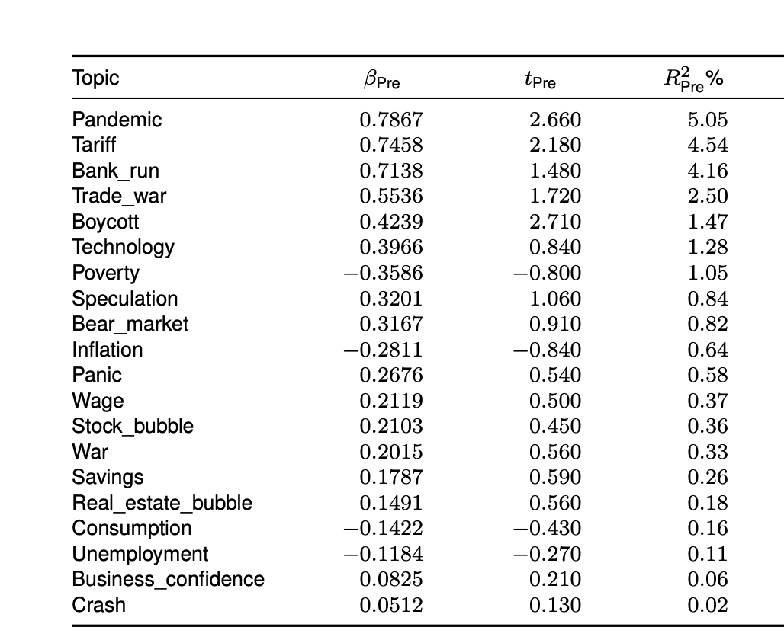
Our replication – Wikipedia Pageviews (In-sample)
Replicate in-sample regression using monthly Wikipedia pageviews (2016-2019)
Notes:
Pandemic, Boycott, Bank run show strongest predictive power in-sample
War has a weak signal

Slide 7
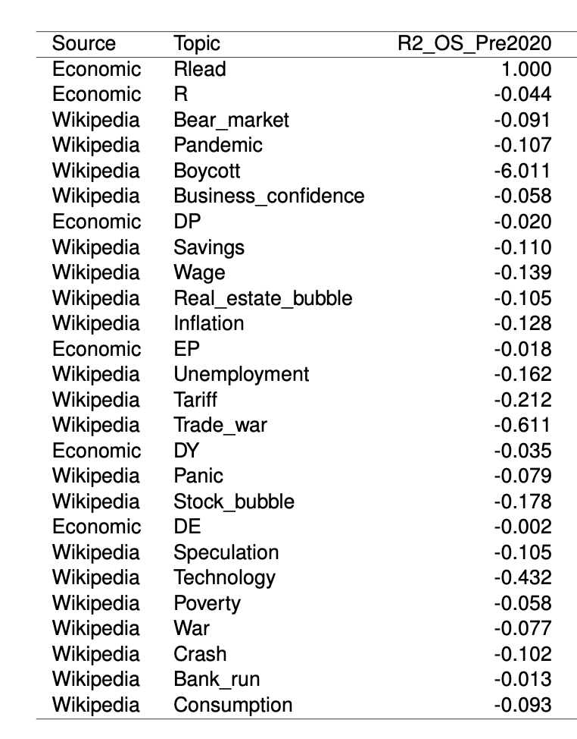
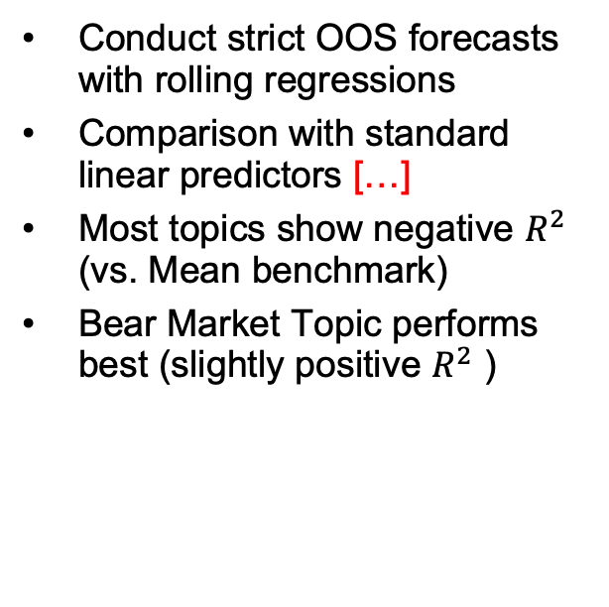
Our Replication – Out-of-sample Analysis
Conduct strict OOS forecasts with rolling regressions
Comparison with standard linear predictors […]
Most topics show negative $R^{2}$ (vs. Mean benchmark)
Bear Market Topic performs best (slightly positive $R^{2}$ )

Slide 8
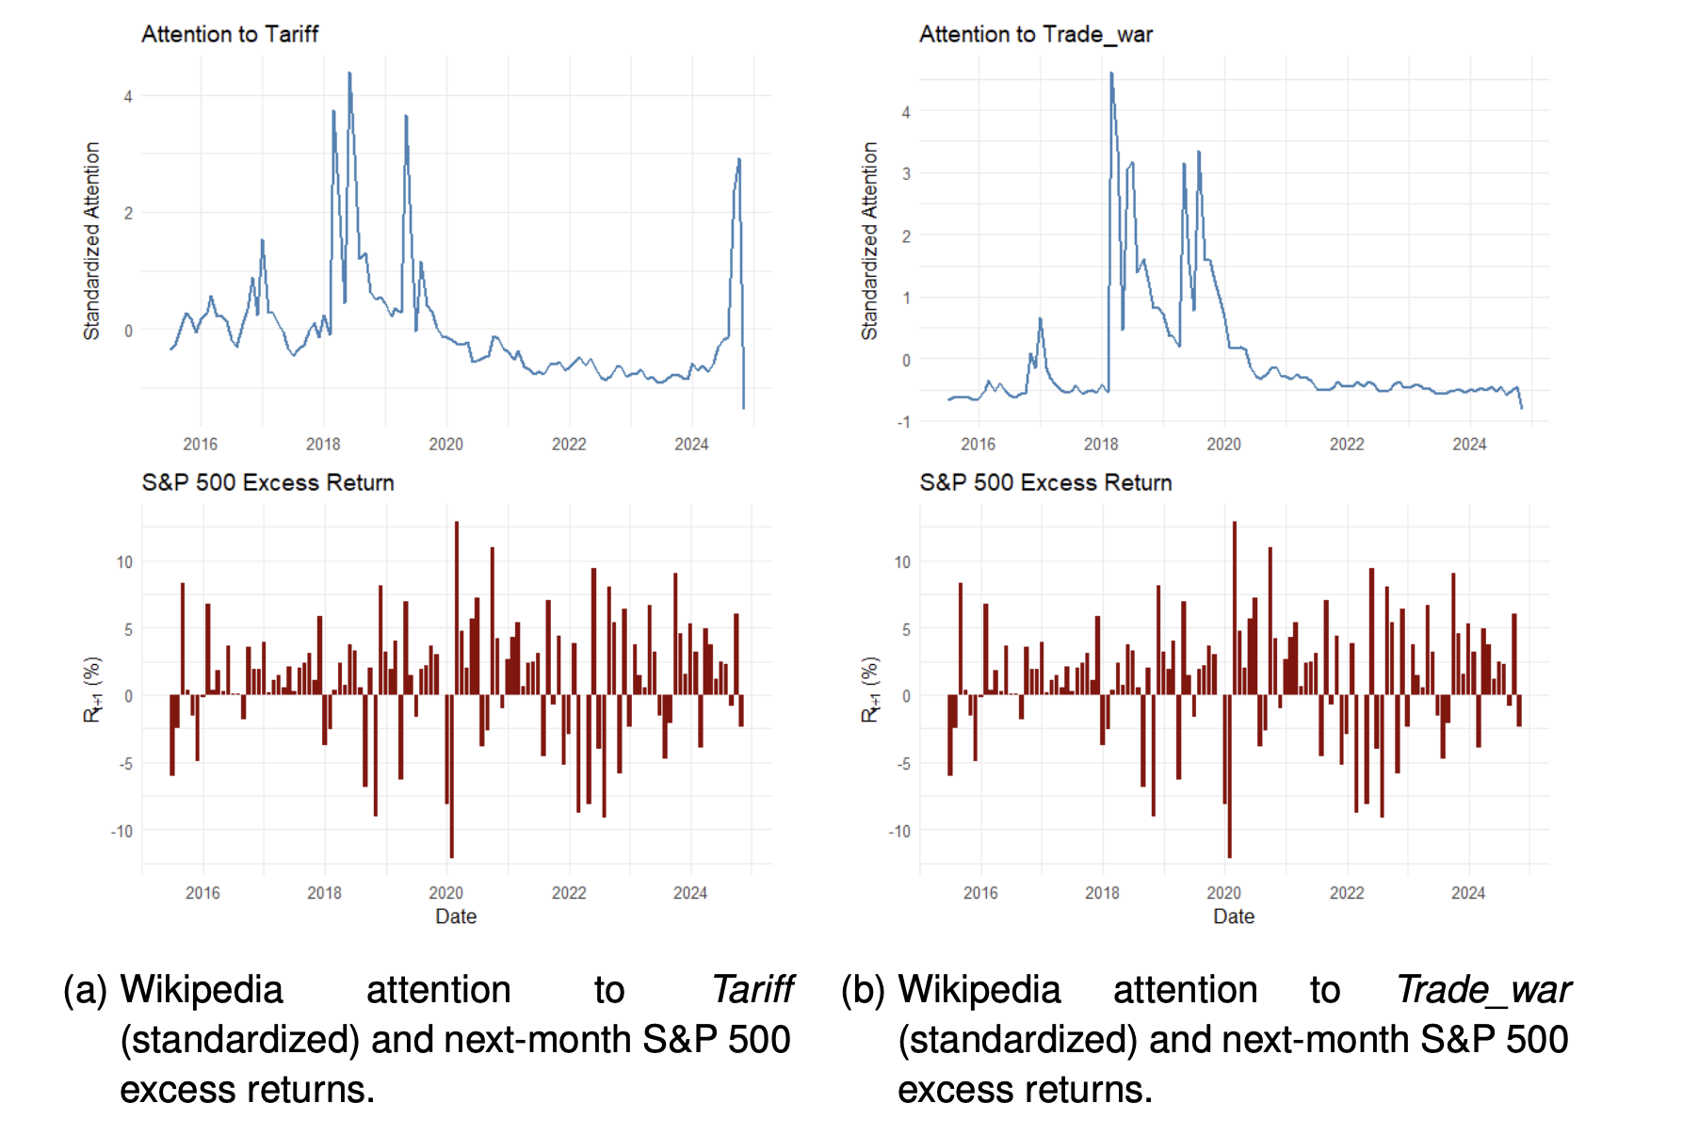
Extension of Hirshleifer et al. (2024) – Two new Topics: Tariff & Trade War
Added due to salience during US-China tensions.
High attention spikes in 2018-2019, moderate predictive power post 2020

Slide 9
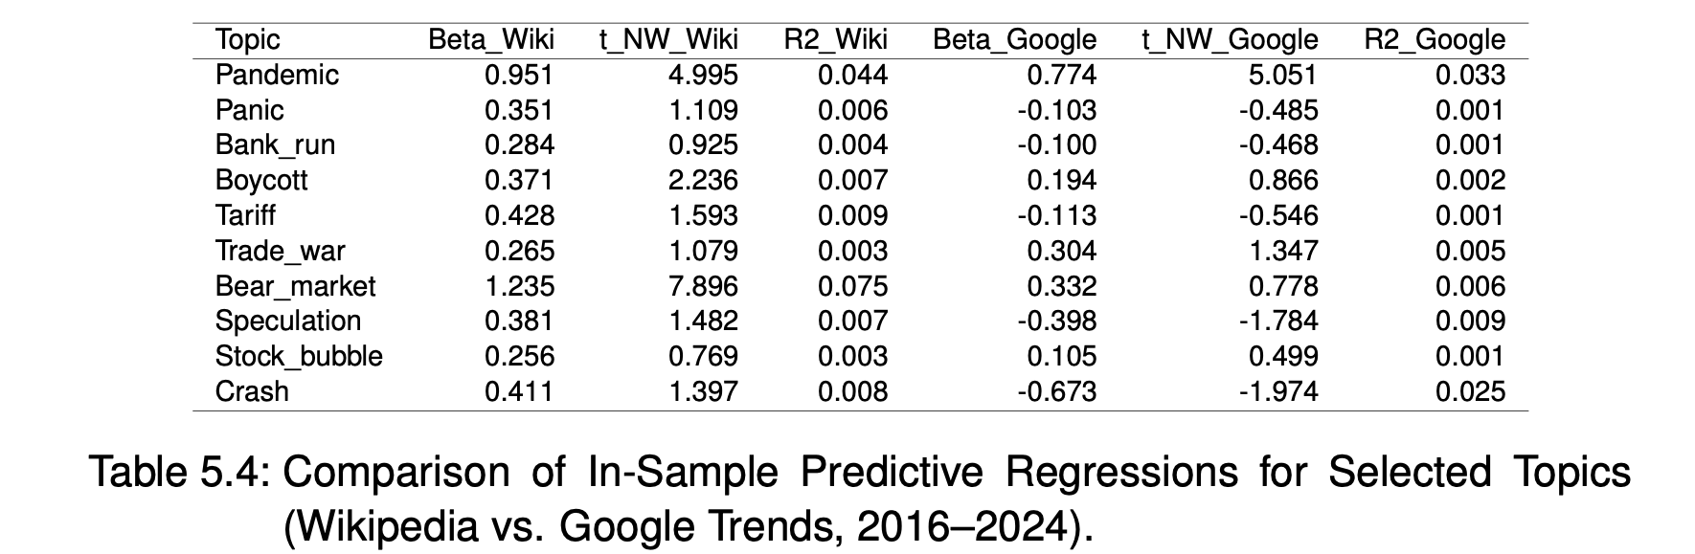
Extension – Google Trends Analysis (In-Sample)
Selection of Topics that:
Had lower predictive power in Wikipedia data (Crash, Panic, Stock bubble)
Are more likely to trigger reactive Google searches than Wikipedia visists (e.g. Speculation, Bank run)
Are benchmarking popular Wikipedia performers
Notes:
Exploratory comparison for 10 topics
Google Trends stronger for crisis terms
Wikipedia stronger for political/ economic discourse (War, Speculation)

Slide 10
Summary of Results
• Disaster attention predicts returns in-sample, especially for Pandemic & Boycott.
• OOS forecasts show weak performance — confirm limits noted in Hirshleifer et al. (2024.
• Google Trends offers complementary but topic-dependent signal strength.
• Replication validates parts of the 'disaster premium' hypothesis.
• Extensions show narrative effects vary over time and platforms.
• Future work: Combine signals, apply multivariate models, expand to global data.

Slide 11
Die Uni-Farben im Überblick
Farbwert Blau sRGB 100%: 125-154-170, Prozentwerte von 100%-10% in 10er-Schritten
Farbwert Beige sRGB 100%: 169-162-141, Prozentwerte von 100%-10% in 10er-Schritten
Mathe/Wirtschaftswissenschaften sRGB 100%: 86-170-28, Prozentwerte von 100%-10% in 10er-Schritten
Ingenieurwissenschaften/Informatik sRGB 100%: 163-38-56, Prozentwerte von 100%-10% in 10er-Schritten
Naturwissenschaften sRGB 100%: 189-96-5, Prozentwerte von 100%-10% in 10er-Schritten
Medizin sRGB 100%: 38-84-124, Prozentwerte von 100%-10% in 10er-Schritten

